Slide 1
OPERATING SYSTEM
BY
ASST PROFESSOR BISHWADEEP MAINALY

Slide 2
Operating System Architecture (4 hrs)
  Review on operating system: OS concepts, System Calls, Process, Threads, CPU Scheduling, Memory, Storage, I/O Management.
  Operating System Design Goals and Principles
  Operating System Structures and Kernel Types: Layered, Monolithic, Microkernel, Hybrid Kernel, Exokernel, Nanokernel, and Modular Kernel
  Kernel Design and Implementation Strategies
  Case Studies : Linux Kernel Architecture, Windows NT Architecture

Slide 3
What is an Operating System?
A program that acts as an intermediary between a user of a computer and the computer hardware
Operating system goals:
  Execute user programs and make solving user problems easier
  Make the computer system convenient to use
  Use the computer hardware in an efficient manner

Slide 4
Computer System Structure
Computer system can be divided into four components:
  Hardware – provides basic computing resources
    CPU, memory, I/O devices
  Operating system
    Controls and coordinates use of hardware among various applications and users
  Application programs – define the ways in which the system resources are used to solve the computing problems of the users
    Word processors, compilers, web browsers, database systems, video games
  Users
    People, machines, other computers

Slide 5
Operating System Definition
OS is a resource allocator
  Manages all resources
  Decides between conflicting requests for efficient and fair resource use
OS is a control program
  Controls execution of programs to prevent errors and improper use of the computer
No universally accepted definition
“Everything a vendor ships when you order an operating system” is a good approximation
  But varies wildly
“The one program running at all times on the computer” is the kernel.
Everything else is either
  a system program (ships with the operating system) , or
  an application program.

Slide 6
KEY RESPONSIBILITIES
Resource management (CPU, memory, I/O devices)
Process management
File system management
Security & protection
User–hardware abstraction

Slide 7
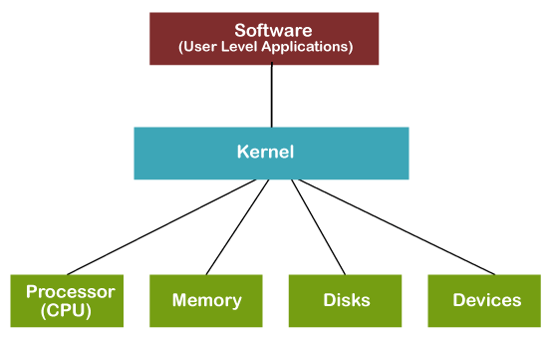
Kernel in Operating System
Kernel is central component of an operating system that manages operations of computer and hardware.
It is the core or heart of an operating system
As Kernel is the core part of an OS; hence it has full control over everything in the system.
Each operation of hardware and software is managed and administrated by the kernel.

Slide 8
User and Kernel Mode
User Mode
The system is in user mode when the operating system is running a user application.
Some examples are word application, PowerPoint, reading a PDF file and browsing the internet.
When the process is in user mode and requires any hardware resource, that request is sent to the kernel.
As there is a limited access to hardware in this mode, it is known as less privileged mode, slave mode or restricted mode.
In user mode, processes get their own address space and cannot access the address space which belongs to the kernel.
So the failure of one process will not affect the operating system. If there is an interrupt, it only affects that particular process.

Slide 9
User and Kernel Mode
Kernel Mode
A kernel the core component of OS which is used to access hardware components of a computer system.
The Kernel mode is a very privileged and powerful mode.
When the process is executing in user mode and if that process requires hardware resources such as RAM, printer etc, that process should send a request to the kernel.
These requests are sent through system calls. Then the computer enters Kernel Mode from user mode.
When the task is completed, the mode changes back to user mode from kernel mode. This transition is known as context switching.

Slide 10
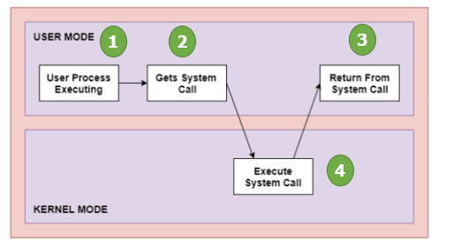
SYSTEM CALLS
A system call is a mechanism that provides the interface between a process and the operating system.
It is a programmatic method in which a computer program requests a service from the kernel of the OS.
Application developers often do not have direct access to the system calls, but can access them through an application programming interface (API).

Slide 11
Types of System Call in OS
Process Control
  This system calls perform the task of process creation, process termination, etc.
File Management
  File management system calls handle file manipulation jobs like create, delete, open, close, read, write etc.
Device Management
  Device management does the job of device manipulation like reading from device buffers, writing into device buffers, request, release etc.
Information Maintenance
  for transferring information between the user program and the operating system
  get time, set time, date etc.
Communications
  Used for inter-process communication
  create connection, close connection, attach remote device etc.

Slide 12
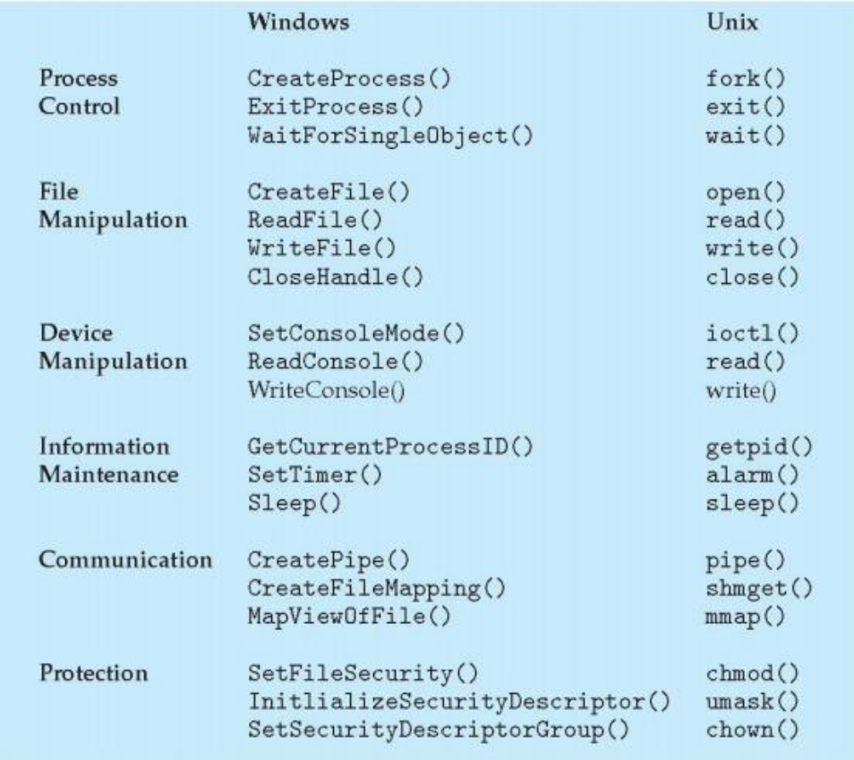
Types of System Call in OS

Slide 13
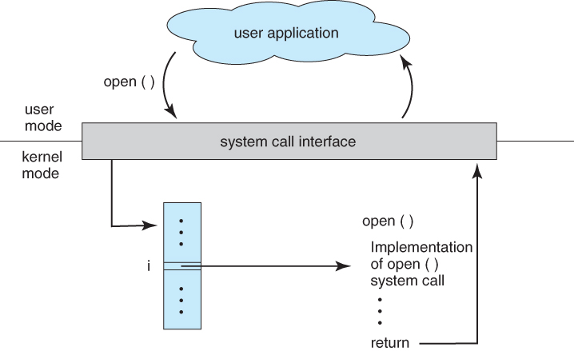
SYSTEM CALLS
Figure: Handling of a user application invoking the open system call

Slide 14
PROCESS
A process is a running program plus its state.
Components:
Program code (text)
Data + heap
Stack
Registers
Program counter
PCB (Process Control Block)
Process States:
New → Ready → Running → Waiting → Terminated
Operations:
Creation, termination, scheduling, inter-process communication (IPC).

Slide 15
THREADS
A thread is a lightweight process sharing process resources.
Types:
User-level threads
Kernel-level threads
Benefits:
Faster context switching
Parallelism on multicore processors
Better resource utilization

Slide 16
Process Scheduling
Determines which process runs on the CPU next.
Criteria:
CPU utilization
Throughput
Turnaround time
Waiting time
Response time
Algorithms:
FCFS
SJF / SRTF
Round Robin
Priority Scheduling
Multilevel Queue
Multilevel Feedback Queue

Slide 17
MEMORY MANAGEMENT
Ensures efficient use of system memory.
Techniques:
Contiguous allocation
Paging
Segmentation
Virtual memory
Page replacement algorithms:
FIFO, LRU, Optimal
Goals:
Protection
Isolation
Efficient allocation

Slide 18
STORAGE MANAGEMENT
Manages how data is stored and accessed.
Components:
File systems (NTFS, ext4, FAT32)
Directory structure
Disk scheduling algorithms
  FCFS, SSTF, SCAN, C-SCAN

Slide 19
I/O Management
Handles communication between hardware devices and system software.
Concepts:
Device controllers and drivers
Interrupts
DMA (Direct Memory Access)
Buffering
Caching
Spooling

Slide 20
OPERATING SYSTEM DESIGN GOALS AND PRINCIPLES
Primary Goals
  Efficiency – maximize hardware usage
  Reliability – prevent failures
  Security – protect processes and data
  Scalability – handle increasing loads
  Portability – run on multiple architectures
  Interactivity – fast response for users

Slide 21
OPERATING SYSTEM DESIGN GOALS AND PRINCIPLES
Design Principles
  Separation of policy and mechanism
  Modularity
  Simplicity
  Performance optimization
  Abstraction layers

Slide 22
Operating System Structures and Kernel Types
1. Monolithic Kernel
Concept
A monolithic kernel is a large kernel where all OS services run in kernel mode, including:
Process management
Memory management
File systems
Device drivers
Networking
System call handling
Inter-process communication
Everything executes with full privileges.

Slide 23
Operating System Structures and Kernel Types
1. Monolithic Kernel
Advantages
Very fast due to direct function calls inside the kernel.
No message-passing overhead.
Good performance for I/O-heavy tasks.
Disadvantages
Difficult to maintain/debug (large codebase).
A bug in any part can crash the entire system.
Security risk—drivers run with full privileges.
Examples
Linux (modern)
UNIX
MS-DOS (simple version)

Slide 24
Operating System Structures and Kernel Types
2. Layered Architecture
Concept
The OS is divided into layers, each built on top of the other.
Layer 0 = hardware
Layer N = user interface
Each layer:
Uses services of layer below
Provides services to layer above

Slide 25
Operating System Structures and Kernel Types
2. Layered Architecture
Advantages
Easy to design and debug.
Each layer is modular.
Strong separation of concerns.
Disadvantages
Performance overhead (must pass through layers).
Hard to define clean boundaries.
Examples
THE OS (classic)
Early Linux-like layered views
Android architecture (somewhat layered)

Slide 26
Operating System Structures and Kernel Types
3. Microkernel
Concept
A microkernel keeps only essential OS functions in kernel mode:
  Inter-process communication (IPC)
  CPU scheduling
  Basic memory management
  Low-level hardware handling
Everything else (drivers, file system, networking) runs in user space as servers.

Slide 27
Operating System Structures and Kernel Types
3. Microkernel
Advantages
Very stable and fault-tolerant—crashes in drivers do NOT crash OS.
Higher security (services isolated).
Disadvantages
Slower due to message-passing overhead.
Complex design.
Examples
Minix 3
QNX (industrial, automotive, aerospace)
Mach (part of macOS XNU kernel)

Slide 28
Operating System Structures and Kernel Types
4. Hybrid Kernel
Concept
A Hybrid Kernel = Monolithic + Microkernel features
It uses:
Monolithic structure (for performance)
Microkernel modularity (for stability)
Some services run in kernel; others run in user mode.

Slide 29
Operating System Structures and Kernel Types
4. Hybrid Kernel
Advantages
Balanced performance and reliability.
Good modularity without too much slowdown.
Disadvantages
Complex to design.
Can become too large over time.
Examples
Windows NT / Windows 10/11 (NT kernel)
macOS, iOS (XNU)
ReactOS

Slide 30
Operating System Structures and Kernel Types
5. Exokernel
Concept
Ultra-small kernel that provides:
  Protection
  Resource allocation
BUT provides no abstractions like:
  File systems
  Virtual memory
  Scheduling
Applications or library OSes must build their own abstractions.

Slide 31
Operating System Structures and Kernel Types
5. Exokernel
Advantages
Extremely fast.
Applications can fully customize OS behavior.
Disadvantages
Very difficult for developers.
Not general-purpose.
Examples
MIT Exokernel project
Aegis OS

Slide 32
Operating System Structures and Kernel Types
5. Exokernel
Advantages
Extremely fast.
Applications can fully customize OS behavior.
Disadvantages
Very difficult for developers.
Not general-purpose.
Examples
MIT Exokernel project
Aegis OS

Slide 33
Operating System Structures and Kernel Types
6. Nanokernel
Concept
A nanokernel is even smaller than a microkernel:
  Only context switching
  Interrupt handling
  Minimal CPU control
Everything else is in user space.

Slide 34
Operating System Structures and Kernel Types
6. Nanokernel
Advantages
Very tiny, simple, fast.
Disadvantages
Extremely difficult to build a full OS on top.
Rare outside real-time or experimental systems.
Examples
L4 microkernel family (some variants act as nanokernels)
Some embedded RTOS prototypes

Slide 35
Operating System Structures and Kernel Types
7. Modular Kernel
Concept
A monolithic kernel that can load and unload parts dynamically, called “modules” or “kernel extensions”.
Modules include:
  File system modules
  Network modules
  Device drivers
  Crypto modules

Slide 36
Operating System Structures and Kernel Types
7. Modular Kernel
Advantages
Can add/remove drivers without rebooting.
Easier to maintain than pure monolithic.
Flexible and extensible.
Disadvantages
Still large compared to microkernels.
Poorly written modules may crash kernel.
Examples
Linux Loadable Kernel Modules (LKM)
FreeBSD modules
Solaris Loadable Modules

Slide 37
Operating System Structure
An operating system is a construct that allows the user application programs to interact with the system hardware.
Operating system can be implemented with the help of various structures.
The structure of the OS depends mainly on how various components and services of the operating system are interconnected and melded into the kernel (core component of OS).
  Simple Structure
  Layered Structure
  Monolithic Structure
  Micro-Kernels
  Client Server Model
  Virtual Machines

Slide 38
Operating System Structure-Simple Structure
Such operating systems do not have well defined structure and are small, simple and limited systems.
The interfaces and levels of functionality are not well separated.
MS-DOS is an example of such operating system. In MS-DOS application programs are able to access the basic I/O routines.
These types of operating system cause the entire system to crash if one of the user programs fails.

Slide 39
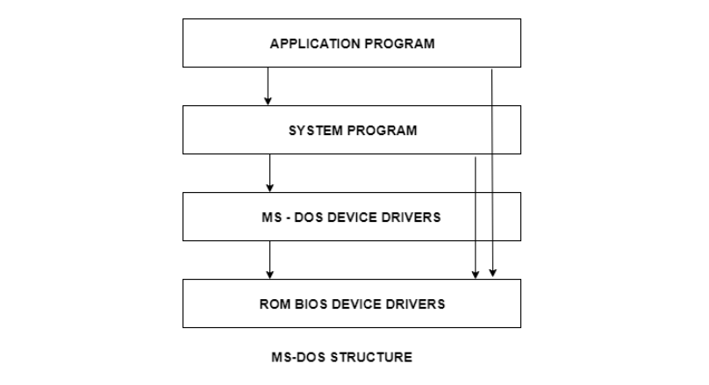
Operating System Structure-Simple Structure

Slide 40
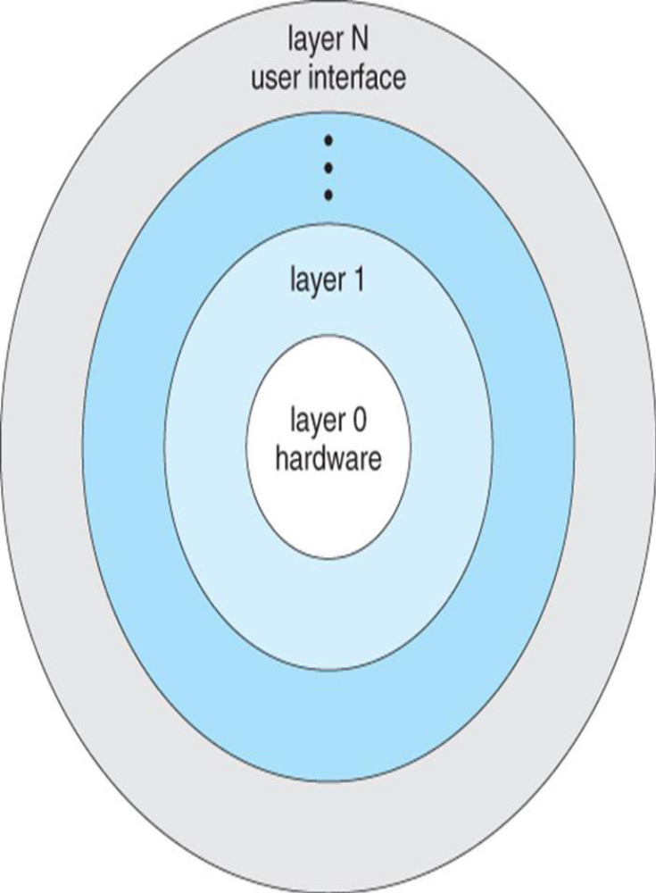
Layered Structure
Operating system is broken down into number of layers/levels
The bottom layer (layer 0) is the hardware and the top layer (layer N) is the user interface
The layers are implemented such that each layer uses functions and services of only lower layer levels
A layer does not need to know how these operations are implemented; it only needs to know what these operations do
This approach simplifies debugging and system verification

Slide 41
Layered Structure
The first layer can be debugged without any concern for the rest of the system, because, by definition, it uses only the basic hardware (which is assumed correct) to implement its functions
Once the first layer is debugged, its correct functioning can be assumed while the second layer is debugged, and so on
If an error is found during the debugging of a particular layer, the error must be on that layer, because the layers below it are already debugged
The major difficulty with this approach is how to differentiate one layer from another
The second problem with layered implementation is that they tend to be less efficient than other types (system call chain which is time consuming)
Example for layered structure: THE System (THE OS) by Dijkstra and his students (six layered batch system)

Slide 42
Monolithic Structure
In this approach, entire OS runs as a single program in the kernel mode.
This increases the size of the kernel as well as the operating system.
The operating system is written as a collection of procedures, each can call any of the other ones whenever it needs to.
Although the design follows the separation of concerns ,no any attempt is made to restrict the privileges to the individual procedure of the operating system, i.e. the entire OS runs with maximum privileges (kernel mode)
In terms of information hiding, there is none; each procedure is visible to other procedure
CP/M(Control Program for Microcomputers) and DOS (Disk Operating System) are simple examples of monolithic operating systems

Slide 43
Micro-Kernels
Running all the OS services in the kernel space can be dangerous because bugs in the programs running in kernel space can bring down the system instantly
For example, in monolithic system where audio driver is running in kernel space, a buggy audio driver can easily reference an invalid memory address and bring the whole system down
The basic idea to get rid of this problem is to Move as much from the kernel into “user” space (making the kernel as small as possible)
This method structures the operating system by removing all non-essential components from the kernel and implementing them as system and user-level programs, result being a smaller kernel

Slide 44
Micro-Kernels
In general, micro-kernels typically provides minimal process and memory management, in addition to communication facility
The client program and the services never interact directly. Rather they communicate indirectly by exchanging messages with micro-kernel
One of the benefit of micro-kernel approach includes ease of extending the OS. All new services are added to user space and consequently do not require modification of the kernel
The micro-kernel also provides more security and reliability, since most services are running as user process rather than kernel process . If a service fails, the rest of the operating system remains untouched

Slide 45
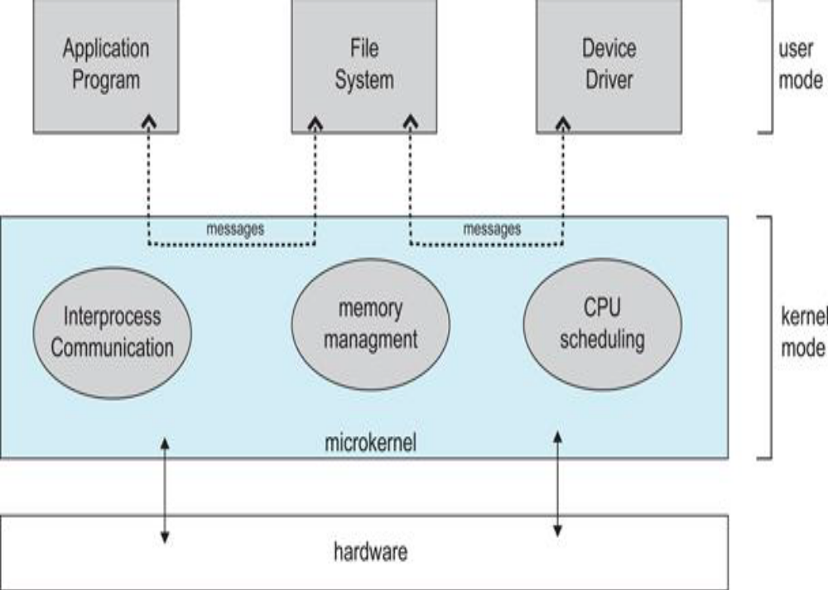
Micro-kernel

Slide 46
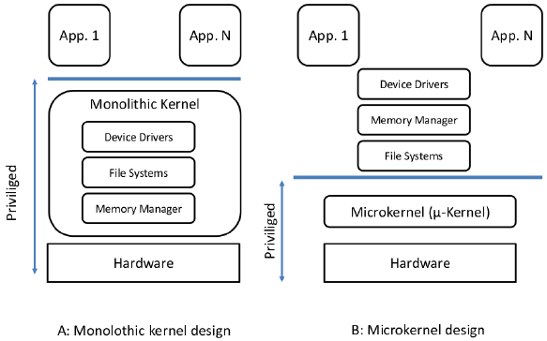
Monolithic vs Micro Kernel

Slide 47
Monolithic vs Micro Kernel
Monolithic Kernel | Micro Kernel
It is larger in size | It is smaller in size than monolithic kernel.
Fast Execution | Slow Execution
Kernel contains the OS Services | OS Services and Kernel are separated.
Failure in one component affects the entire system. | Failure in one component will not affect the other components.
Hard to debug | Easy to debug
Difficult to add new functionalities | Easier to add new functionalities.
Example: Linux, BSDs, Solaris, OS-9, DOS, OpenVMS, etc. | Example: Symbian, L4Linux, K42, Mac OS X, PikeOS, HURD, etc.

Slide 48
Client Server Model
The usual approach is to implement most of the OS functions in the user/client processes
The client process/user process sends a request to the server process (OS services)
The OS is split into parts, each of which handles only one task of the system like file service, process service, memory service etc.
The parts are small and manageable
Since all services run as user mode processes, they do not have direct access to the hardware
Client and server processes may be running on a same machine or different machines (usually in case of distributed system).

Slide 49
Virtual Machines
Virtual machines are an efficient, isolated duplicate of a real computer machine
Virtual Machine abstracts the hardware of our personal computer such as CPU, disk drives, memory, NIC (Network Interface Card) etc, into many different execution environments as per our requirements, hence giving us a feel that each execution environment is a single computer.
There are two basic types of virtual machines
  Process Virtual Machine
  System Virtual Machine
Examples: VMWare, Virtual Box, Hyper-V, Oracle VM, Virtual PC,etc.

Slide 50
Virtual Machines
Process Virtual Machine
  A process virtual machine allows us to run a single process as an application on a host machine.
  The process VM is created when process begins and it ends when process gets terminated
  An example of a process virtual machine is the Java Virtual Machine (JVM)
System Virtual Machine
  The system VM simulates the complete system hardware stack and supports the execution of complete operating system.
  This virtualization process relies on a hypervisor also called as Virtual Machine Monitor(VMM) that helps to share and manage hardware, allowing for multiple environments.
  Example: VMWare, Xen, etc.

Slide 51
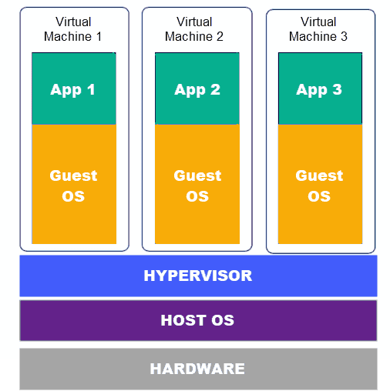
Virtual Machines

Slide 52
CASE STUDY: LINUX KERNAL ARCHITECTURE
Assignment 1: Comparative Architectural Analysis
Type: Individual Research Paper Length: 8–12 pages
Task
Conduct an in-depth comparative study of Linux Kernel Architecture vs. Windows NT Architecture, focusing on:
Kernel type (monolithic, hybrid, modular)
System call mechanism
Process and thread management models
File system architecture (ext4, NTFS)
Memory management strategies
Device driver framework
Security models (LSM vs. Windows Security Reference Monitor)
Inter-process communication (IPC)
Deliverables
A technical research paper with diagrams
At least 10 scholarly references (IEEE/ACM preferred)
Comparative table summarizing all differences
Outcome
The student must demonstrate strong theoretical and analytical skill by synthesizing architectural differences and analyzing performance/security implications.

Slide 53
CASE STUDY: LINUX KERNAL ARCHITECTURE
Assignment 2: Kernel Source Code Investigation (Linux)
Type: Practical + Research Length: 5–7 pages report
Task
Explore the Linux kernel source code (choose any stable version ≥5.0) and analyze:
Organization of source tree (/kernel, /mm, /fs, /drivers)
How system calls are implemented (syscall_64.tbl, sys_xxx functions)
Kernel module loading flow (insmod, modprobe)
Scheduling implementation (CFS scheduler)
Deliverables
Code snippets with explanations (no modification required)
Flow diagrams of system call and scheduling paths
Reflection on design philosophy (“Everything is a file”, modularization)
Outcome
Students will understand real kernel internals, not just theory.

Slide 54
CASE STUDY: LINUX KERNAL ARCHITECTURE
Assignment 3: Windows NT Executive Components Study
Type: Research Essay Length: 6–10 pages
Task
Study the internal architecture of Windows NT focusing on:
NT Executive components (Object Manager, Memory Manager, I/O Manager, Process Manager)
Role of “Executive vs. Kernel” layers
Windows Subsystem (Win32, MS-DOS, POSIX history)
Internal IPC (ALPC)
HAL (Hardware Abstraction Layer)
Deliverables
Diagram of Windows NT layered architecture
Explanation of how Windows NT differs from pure microkernel or monolithic design
Case study of a real component (e.g., object manager namespace, I/O request packets)
Outcome
Students learn to research closed-source architectures using documentation, books, and reverse-engineering literature.

Slide 55
THANK YOU
───────────────────────────── CONTACT INFORMATION
─────────────────────────────
Asst. Professor Bishwadeep Mainaly
✉ Email: bishwadeepmainaly@gmail.com
📱 WhatsApp: +977-9844686688
───────────────────────────── *Thank you for your attention*
─────────────────────────────

